Slide 1
Equal Education
About Page

Slide 2
Contents
Demonstration
Backend
Frontend
Self Critique
Data Visualization
Developer Critique
Notes:
About page - talk about ourselves (Ailyn starts, Everyone)
Demonstration - walk through
Thesis of the project - landing page (Ailyn)
Pick an Entity - High level desc, data visualizations, Videos, related entities. (Intae)
Visualizations(Kyle)
Entities - Search, Sort, Filter (Jesus)
Backend (Andrew, Prateek)
Hierarchy
Gcloud setup - backend infra: Docker + Django + MySQL
GKE - frontend infra
Searching - Indexers + Google API
Frontend (Intae, Jesus)
Hierarchy
Components, such as instance
Search, Redux, Highlighting, filter, sort
bluh
Self-critique (Kyle)
Challenges
Frontend race condition
Gcloud search Api
MySQL server died one time
Permissions with Gcloud
Lack of Data
Data Visualization - Major minorities(Kyle)
Developer critique (Ailyn)
Bad stuff
White text with white background
Splash page can be improved, removing the header
Person of the week
Overall Layout can be improved
pagination doesn’t need next/prev when not applicable
New tab when going to outside link please
graphically, maybe help button for diversity score
too much loading
Too much empty space in visualizations
why are visualizations
Good Stuff
Great Images with good sizing
dynamic search is cool
Data text representations in text is nice for instances
Cards at the bottom giving previews to related instances is nice
strong imagery

Slide 3
Demonstration
Equal Education

Slide 4
Backend Design

Slide 5








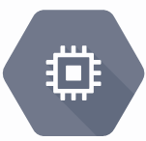
Data Flow
Internet
Index
App Engg
Storage
Load Balancer
GKE
Compute
MySQL

Slide 6





Infrastructure
Docker container running on Kubernetes Cluster(GKE)
Django with Gunicorn
Google’s Cloud SQL

Slide 7



Fast Searching
Python App in GAE
Gcloud Search API
Index on the DB

Slide 8
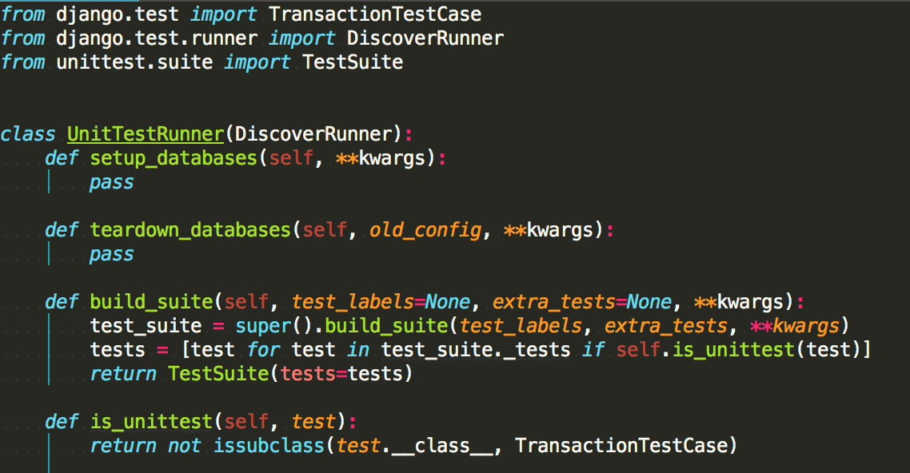

Backend Testing
Django Unit Tests (Python unittests)
Postman for API calls

Slide 9
Frontend Design

Slide 10
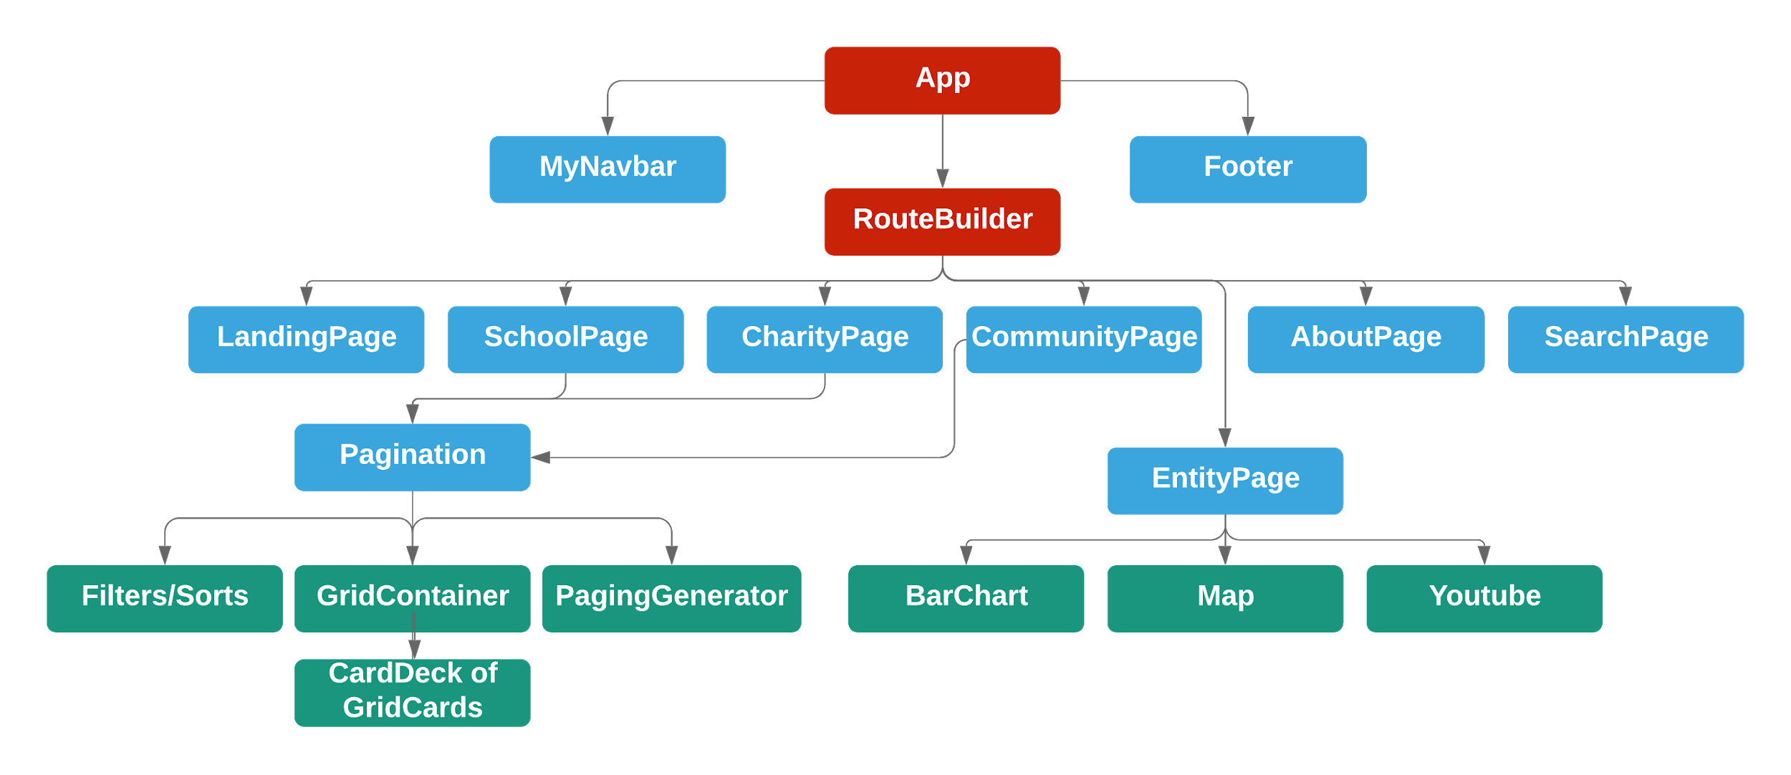
Components Hierarchy

Slide 11
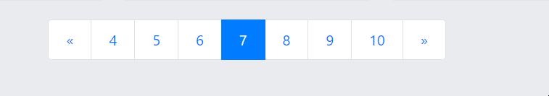
Pagination
Key Features
Durability
http://www.equaleducation.info/schools/2?&Poverty=Extreme&State=Mississippi&sort=Population&desc=true
Pre-caching of all grid pages within pagination range
Dynamic Range with prev/next buttons only appearing when applicable
Reuseable components allowed for quick construction of our grid pages

Slide 12
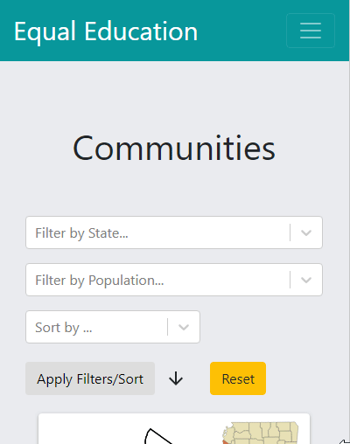
Filtering and Sorting
Key Features
Mix and Match
AutoComplete, especially helpful for large possible fields with known states
Mobile Friendly
Fields are autopopulated by the link, Better user experience
Reset Button for Quick Return to Default

Slide 13
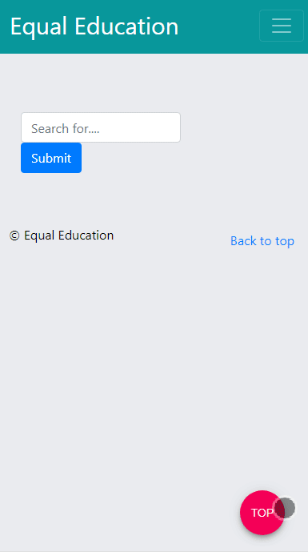
Search w/ Redux
Key Features
Dynamic Buttons allowing quick jump to different categories
Manage search keywords/terms with Redux, allowing highlighter component to easily access them and efficiently do it’s thing
If Search Terms aren’t within normal card info, can be seen and highlighted upon hitting view more
Mobile-friendly
Easy back-to-top FAB for large results
Search Box in menu can be used to easily perform multi-term search within page w/o knowledge of regex

Slide 14
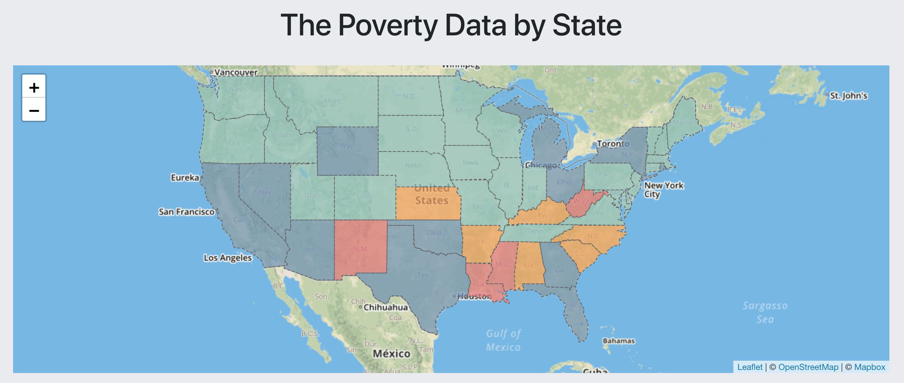
Data Analysis - (1)
Mississippi, Louisiana, New Mexico, West Virginia

Slide 15
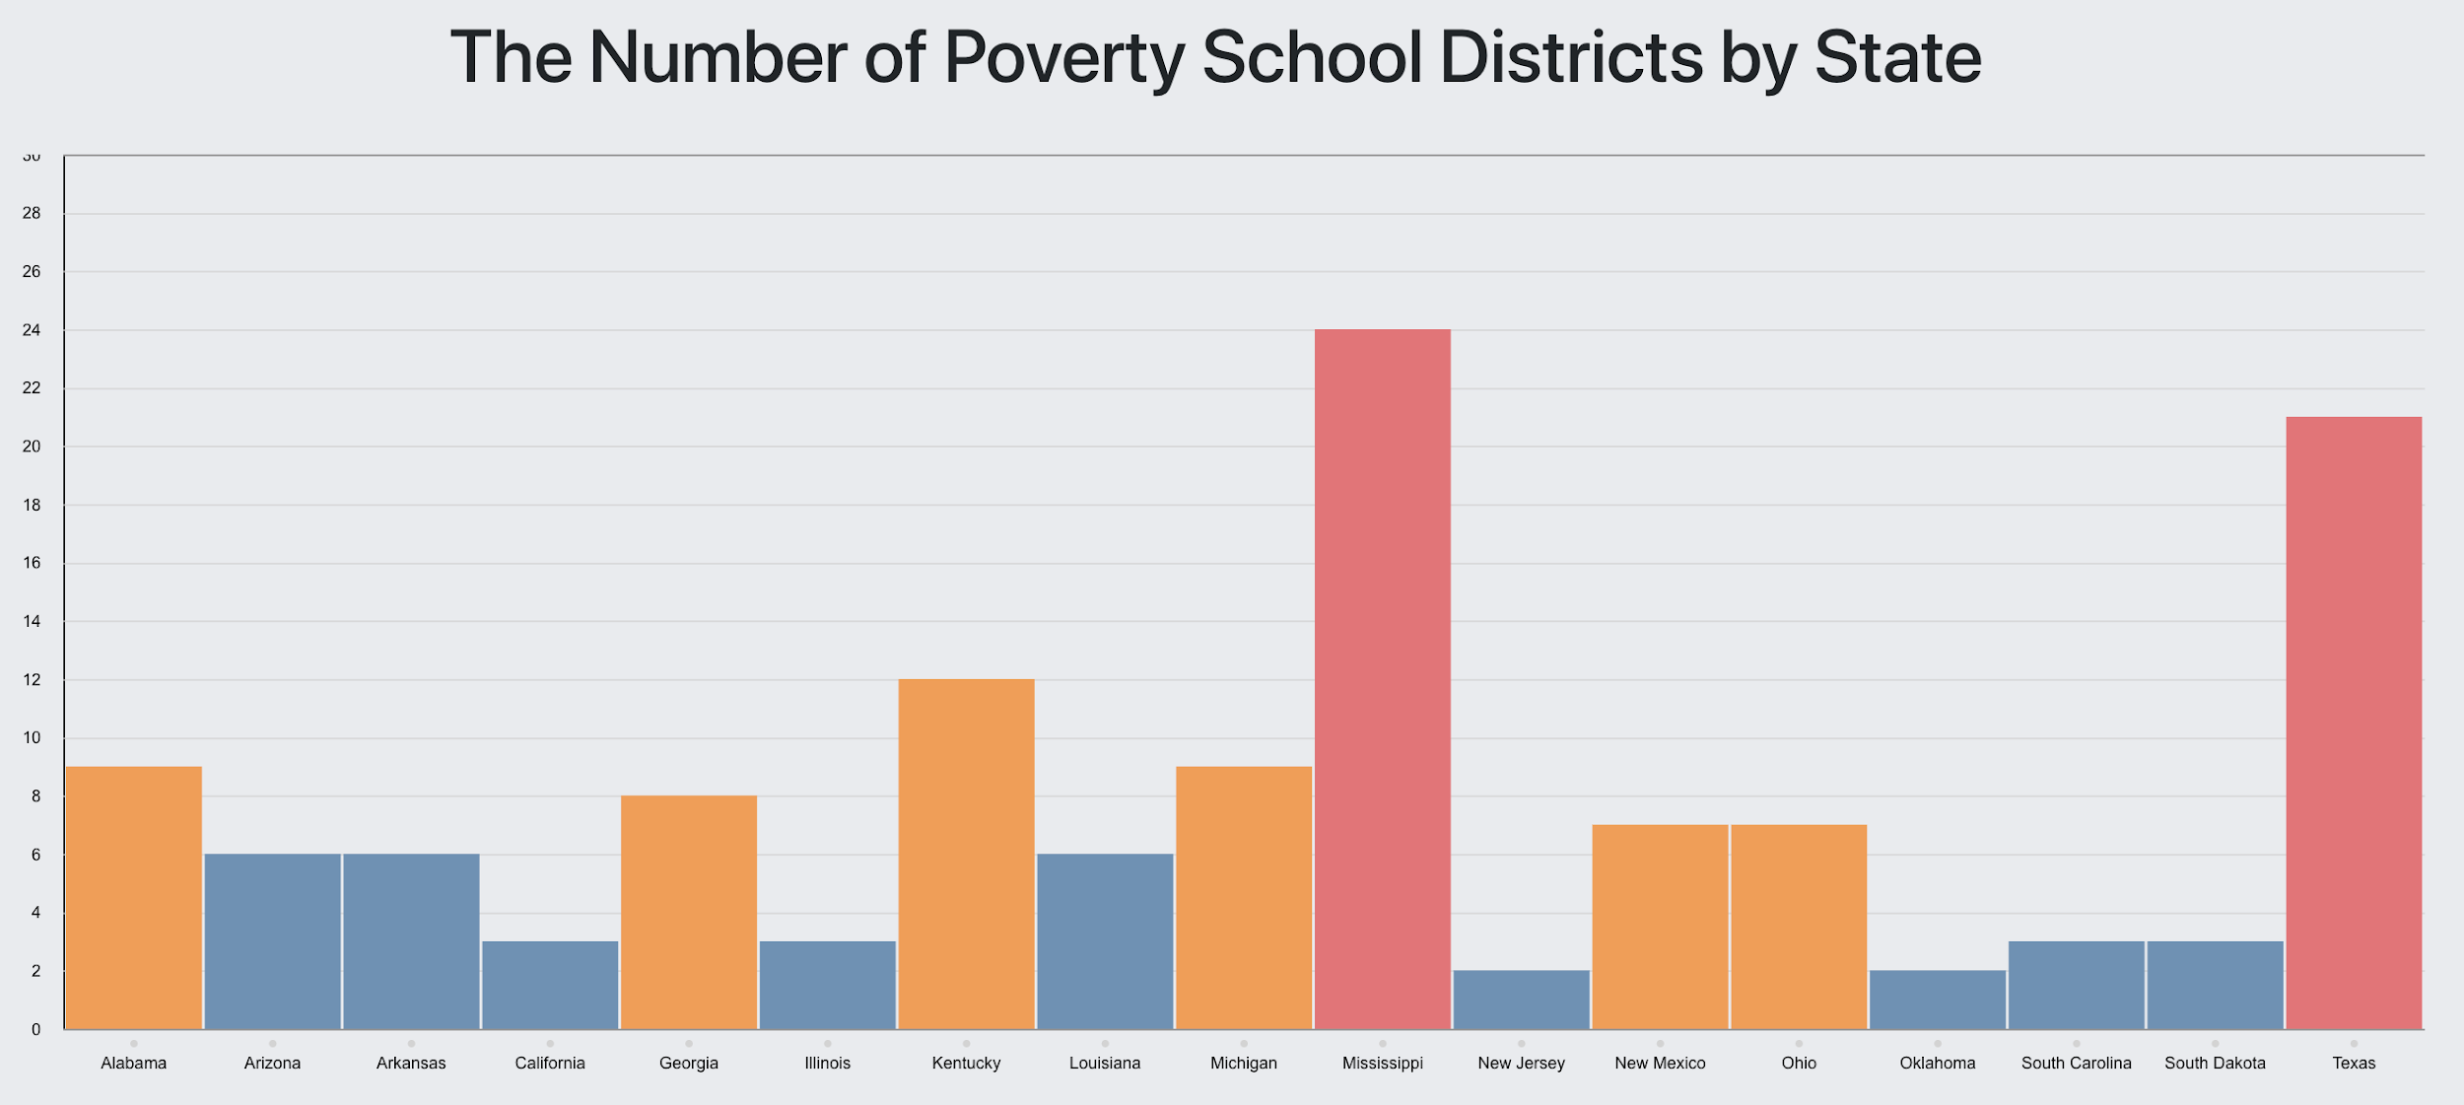
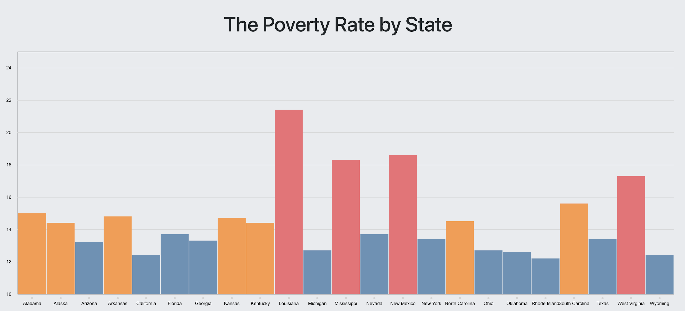
Data Analysis - (2)
Mississippi, Texas → AVG = 22.5 school districts
Others → AVG = 1.81 school districts
Mississippi, Louisiana, New Mexico, West Virginia
21.14%(Louisiana) - 7.7%(Colorado) = 13.44%!
The gap between each state is high → Our site can help!

Slide 16
Self Critique
Positive:
Website is fast
caching, redux
Good use of reusable components
Extra media
Searching, filtering
Negative:
Lack of Data
Styling; messy, too homogeneous
Scheduling issues
Start with React from the beginning
What We Learned:
React, GCP, various tools
The amount of teamwork/communication necessary for this project
The number of things that can go wrong at any given moment

Slide 17
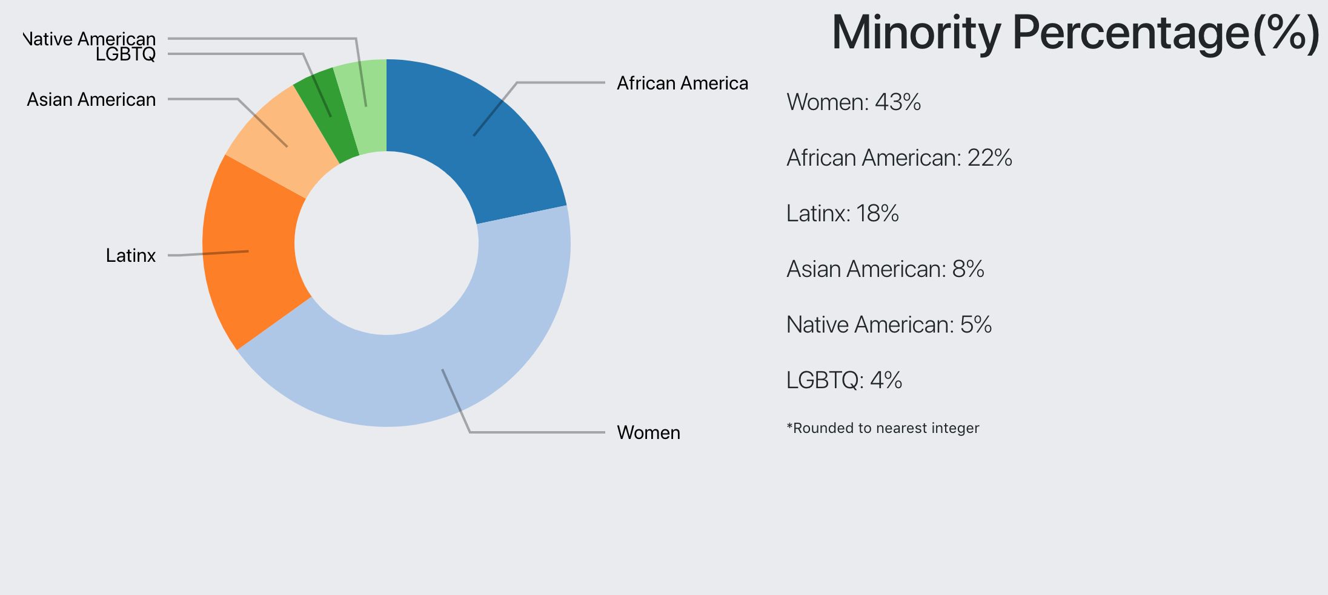
Our Developer Site Visualizations - (1)

Slide 18
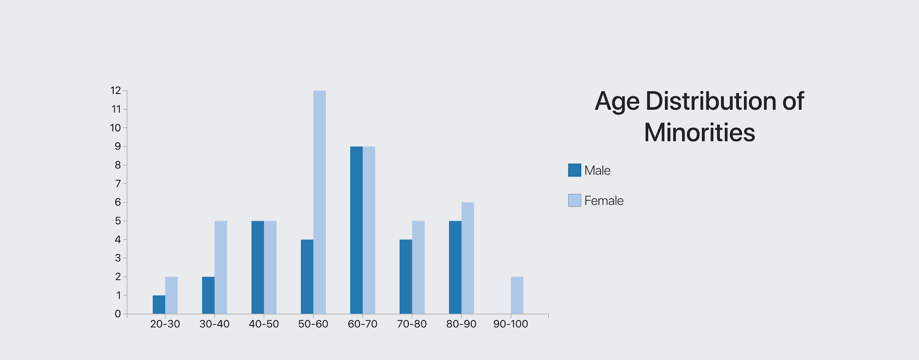
Our Developer Site Visualizations - (2)

Slide 19
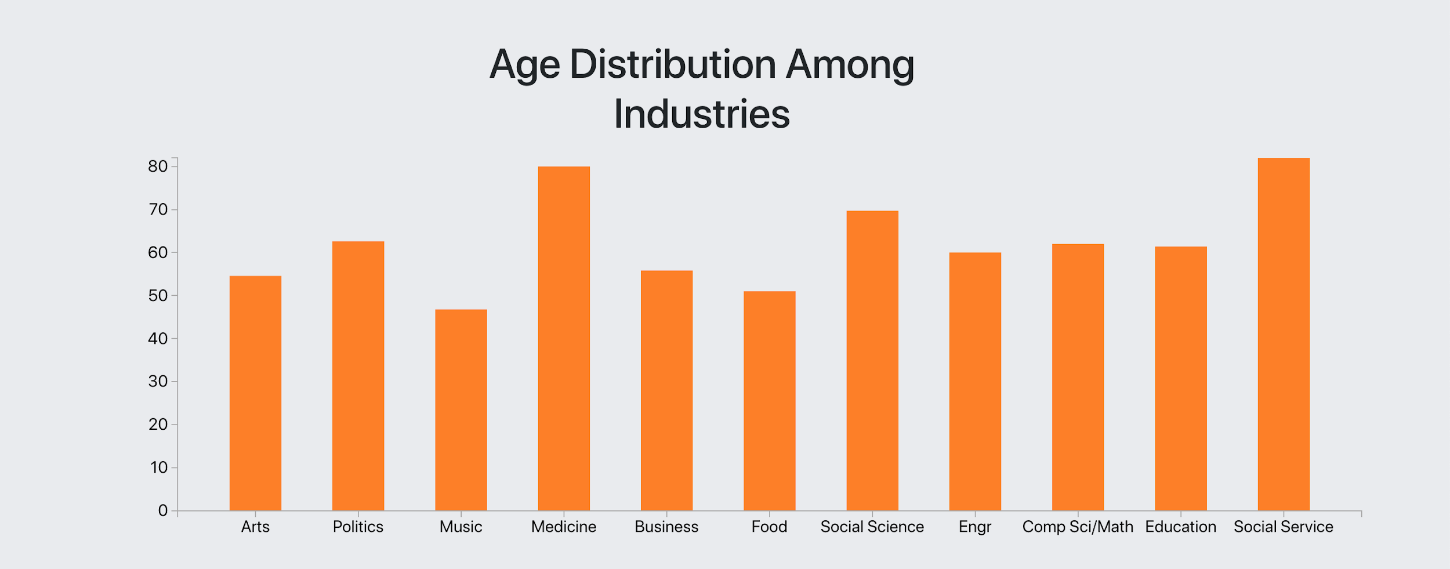
Our Developer Site Visualizations - (3)

Slide 20
Developer Critique
http://majorminorities.me/
Positive:
Great images with good sizing
Dynamic search
Data text representations in text is nice for instances
Cards at the bottom giving previews to related instances is nice
Strong imagery
Person of the week
What we learned:
Imagery makes it interesting and captivating
Minorities and their representation
Improvements:
Splash page
Carousel white text with white background
Person of the week
Pagination doesn’t need next/prev when not applicable
New tab when going to outside link
Too much loading
Empty space at bottom of visualizations
More diversity (e.g. Asian-American representation, LGBTQ, younger ages, etc)
Layouts
What puzzles us:
About page loading time

